Slide 1
Word Seeker
Alvin Yang
Insight Data Engineering, Boston
Notes:
Introductory sotry
Gc explain plain way

Slide 2
A prompter
_____ sunshine
bright sunshine 3100
warm sunshine 2900
eternal sunshine 2200
glorious sunshine 1400
…
different _____ them
different from them 25600
different for them 9500
different about them 4700
different to them 2300
…
Supply example sentence to help understand:
Students learn how to handle working with people who are different from them.
Notes:
My project built a tool to give users word recommendations according to the number of occurrences in a large corpus
We also supply users with a bunch of example sentences to see how other people use this phrase.

Slide 3


Architecture
803.5GB
48GB
Notes:
Spark 8 nodes
Hbase on top of spark-cluster
Redis 3 nodes,
Two purpose:
to boost the sentence-idf algorithm
Store hot data for query, improve user experience
Django 3 nodes with load balancer
High frequency words into redis

Slide 4
Algorithm
Word candidates
(different from them, 317) => (different,____,them),[(from, 317)] (different for them, 128) => (different,____,them),[(for, 128)]
… …
N-gram | count
Different from them | 317
Different for them | 128
… | …
Partition Key | Column Key | Cell (Value)
different,___them | from | 317
 | for | 128
 | … | …
N-gram count table
Candidates result table in HBase
Notes:
We take 3-gram as an example, if we want to get the middle words with in a phrase.
# of Ngram are filtered if # < 40

Slide 5
Algorithm
A Lannister always pays his debt (sentence ID: 5)
2-gram: (A Lannister,5), (Lannister always, 5), (always pays, 5), (pays his, 5), (his debt, 5)
3-gram: (A Lannister always,5), (Lannister always pay, 5) ,(always pay his, 5), (pay his debt, 5)
4-gram: (A Lannister always pays,5), (Lannister always pay his, 5), (always pay his debt,5)
5-gram: (A Lannister always pays his,5), (Lannister always pay his debt,5)
Partition Key | Column Key | Cell (Value)
different,___them | from | (317, [21,43,14,153…]
 | for | (128, [23,63,17,93…]
 | … | …
Notes:
the more an ngram commonly seen, the more sentences it appears in.
To this ngram, this sentence seems not that important compared with other sentence, so it should get comparative low score.
If we pick the highest score sentences, it would cover most
So how to solve this problem.

Slide 6
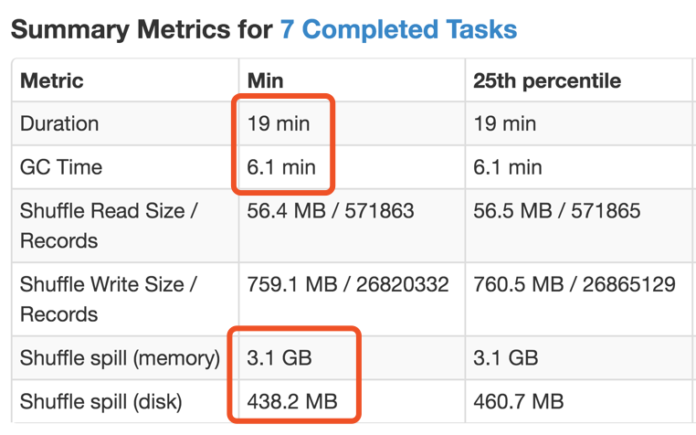
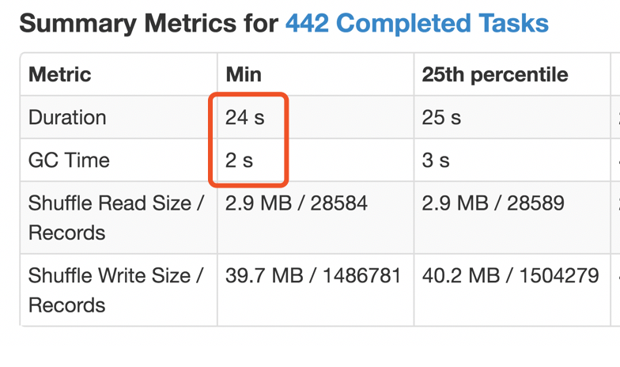
Technical Challenge
How to make spark run fast w/o exception?
partition(task) size
spark.memory.fraction
functional programming paradigm
executor-cores
default.parallelism
1/3
1/10

Slide 7
Technical Challenge
How to insert faster ?
bulk load by Hfile
Pre-spit the table into 70 region
Salted key approach to avoid complete key sorting.
Prepend partition number: 91:___,sunshine
Benchmark
Locality is optimum(One)
Insert 127M records with in 10 minutes*
*Eight r4.large EC2 nodes with 16 GB memory
Notes:
Comparasion

Slide 8


Zhiyong Yang.
NYU, Masters in Computer Science, May 2018
Jilin University, China, Bachelors in Physics, July 2013
Camera / Photo
Hiking
Notes:
3 peer review
Upload gdrive

Slide 9
Thank You !

